Slide 1
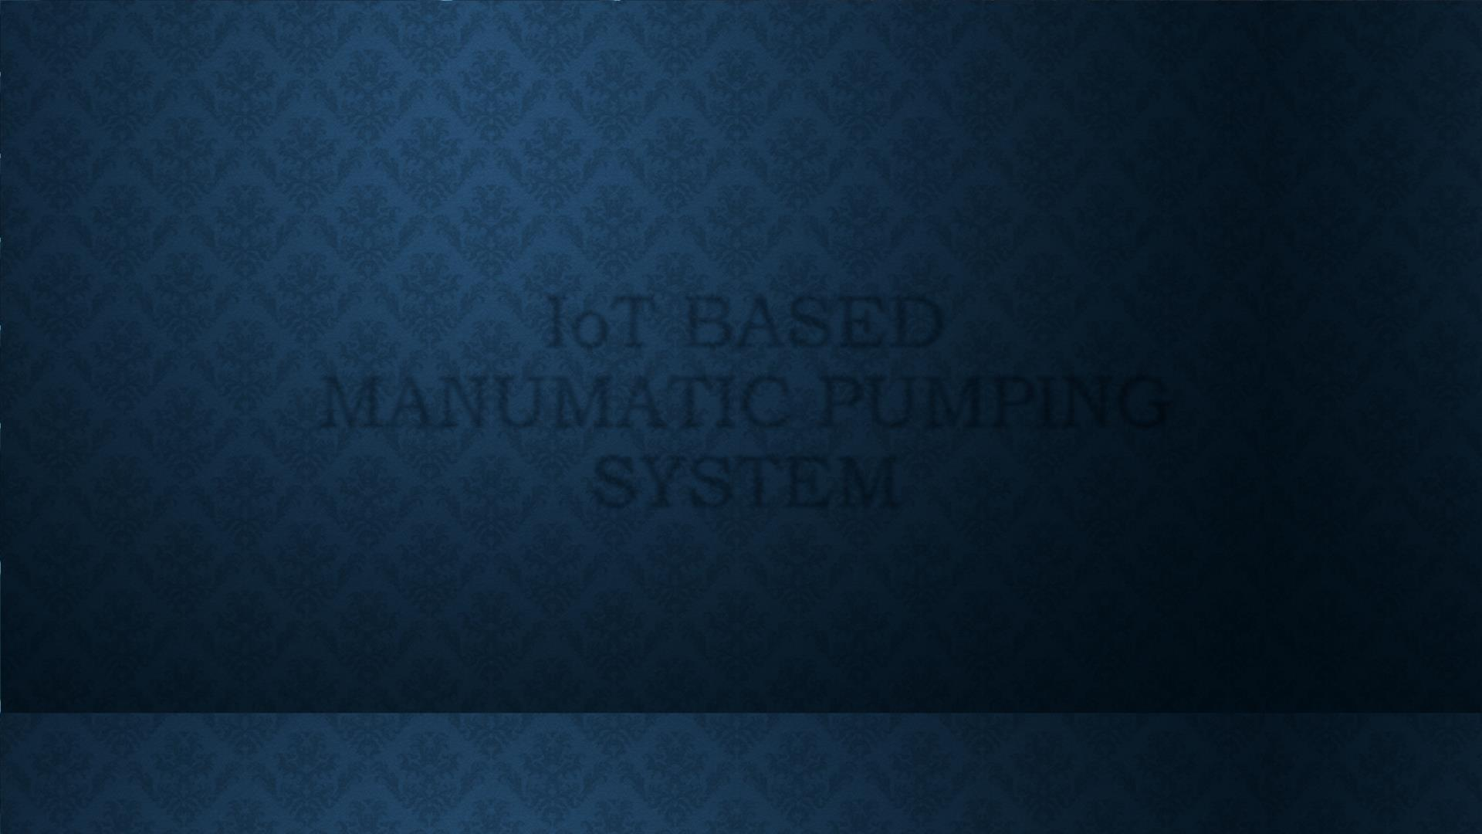
IoT BASED
MANUMATIC PUMPING
SYSTEM

Slide 2

OPEN SOURCE TOOLS
Open source is a term that originally
referred to open source software (OSS).
Open source software is code that is
designed to be publicly accessible –
anyone can see, modify, and distribute
the code as they see fit.
Some of the examples are,
o Arduino
o GNU/Linux
o Mozilla Firefox
o Apache web server
o LibreOffice

Slide 3
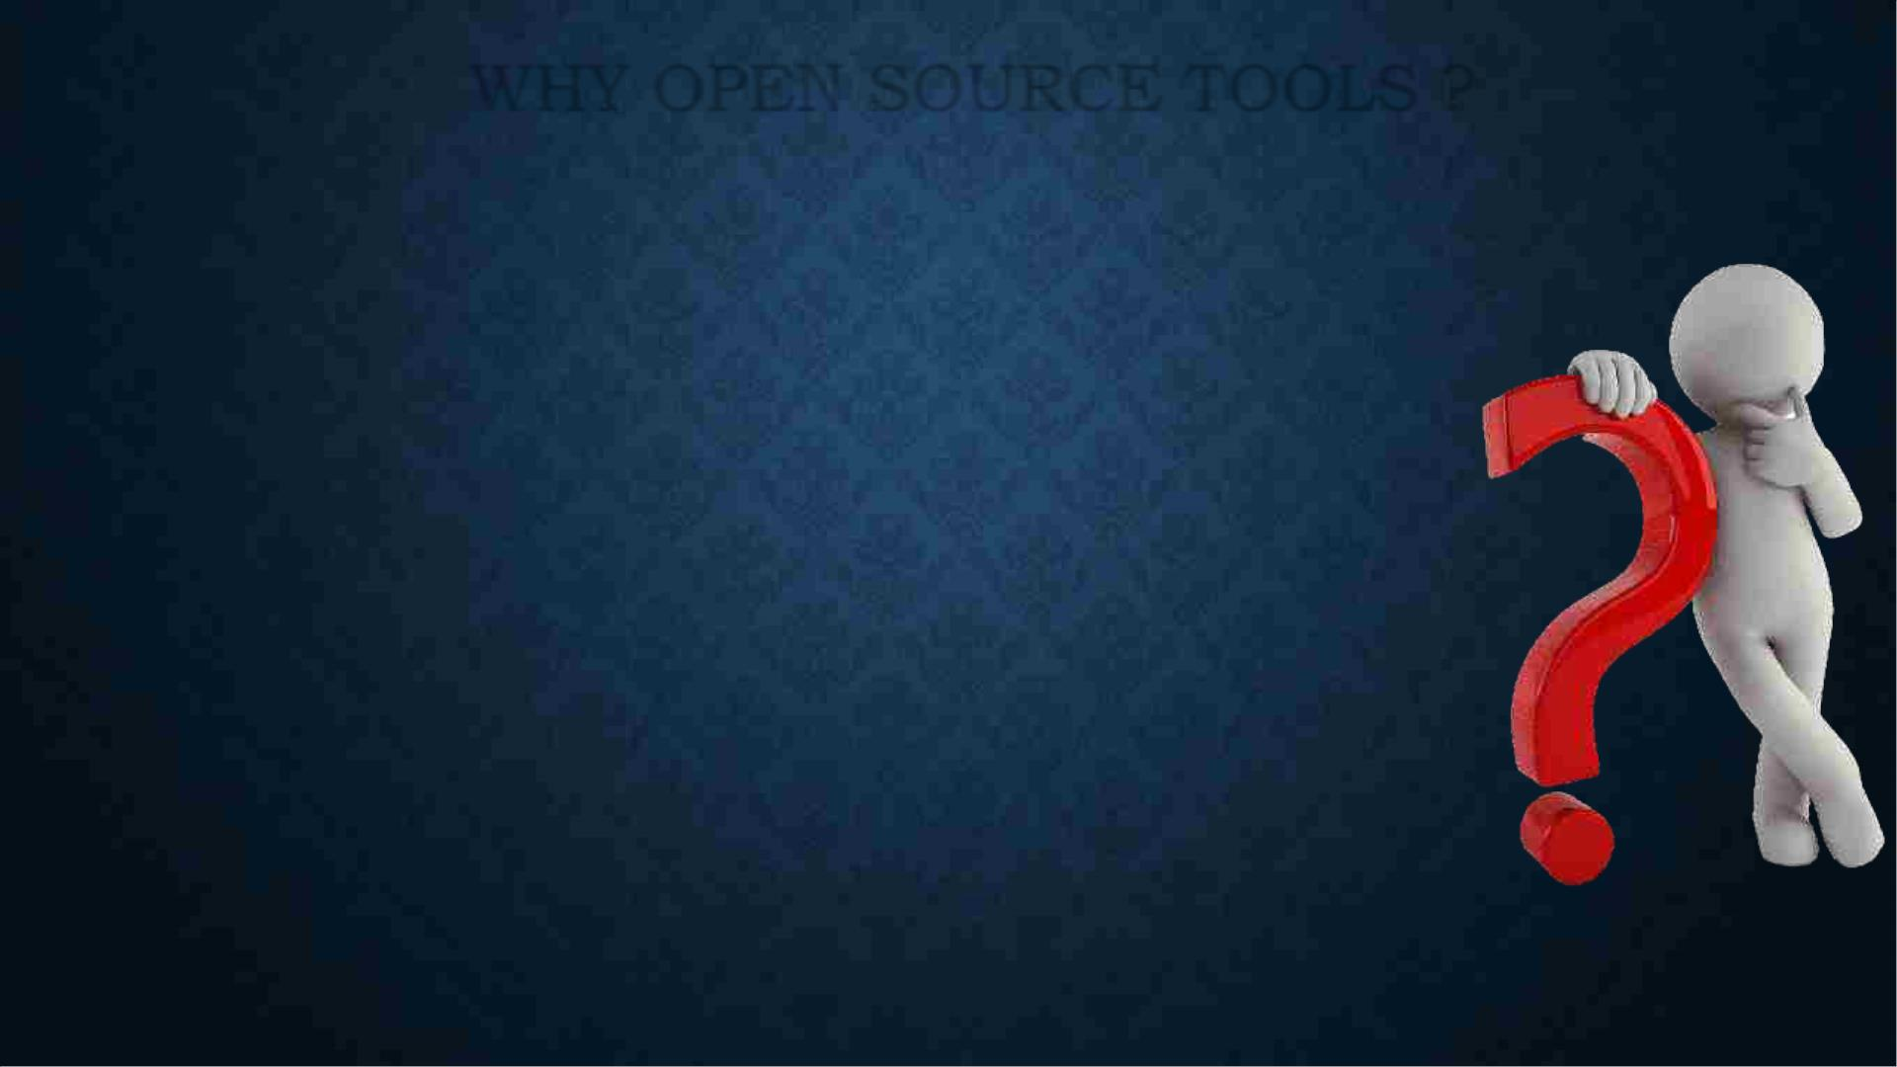
WHY OPEN SOURCE TOOLS ?
Control:
Users who aren't programmers also benefit from open source software, because
they can use this software for any purpose they wish - not merely the way someone
else thinks they should.
Training:
Open source code is publicly accessible, students can easily study it as they
learn to make better software.
Security:
It is more secure and stable than proprietary software because anyone can view
and modify open source software, someone might spot and correct errors or
omissions that a program's original authors might have missed.
Stability:
Many users prefer open source software to proprietary software for important,
long-term projects.

Slide 4
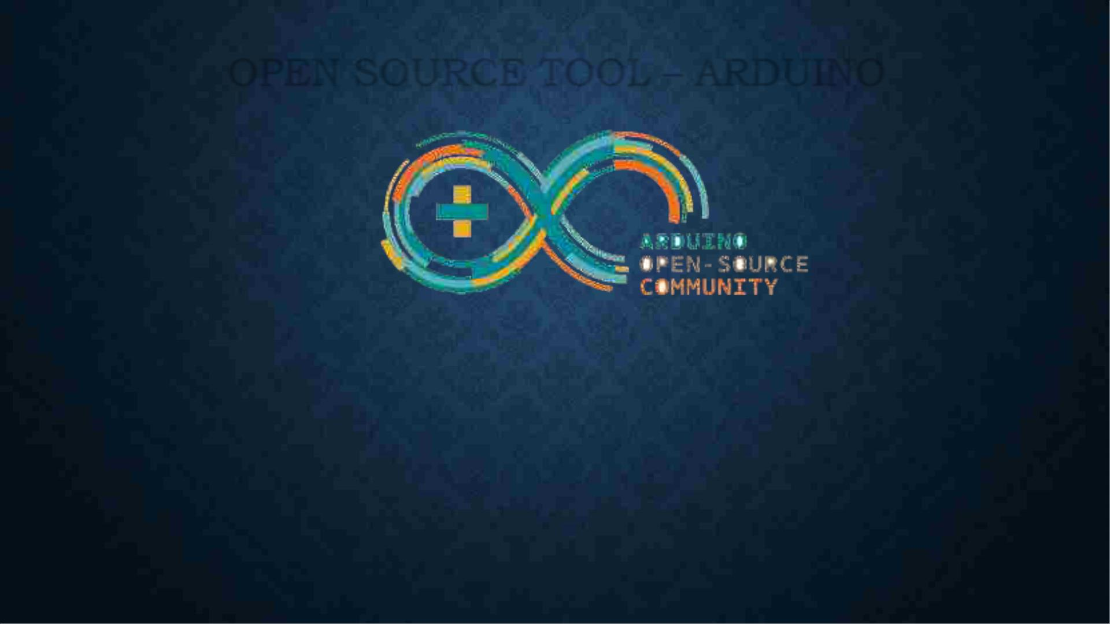
OPEN SOURCE TOOL – ARDUINO
Arduino is an open-source electronics platform based on easy-to-use hardware and
software. Arduino boards are able to read inputs - light on a sensor, a finger on a button, or a Twitter
message - and turn it into an output - activating a motor, turning on an LED, publishing something
online. You can tell your board what to do by sending a set of instructions to the microcontroller on the
board. To do so you use the Arduino programming language (based on Wiring), and the Arduino
Software (IDE), based on Processing.

Slide 5

WHY ARDUINO ?
The Arduino software is easy-to-use for beginners, yet flexible enough
for advanced users. It runs on Mac, Windows, and Linux. Teachers and
students use it to build low cost scientific instruments, to prove chemistry
and physics principles, or to get started with programming and robotics.
Arduino is a key tool to learn new things and can start tinkering just
following the step by step instructions of a kit, or sharing ideas online.

Slide 6
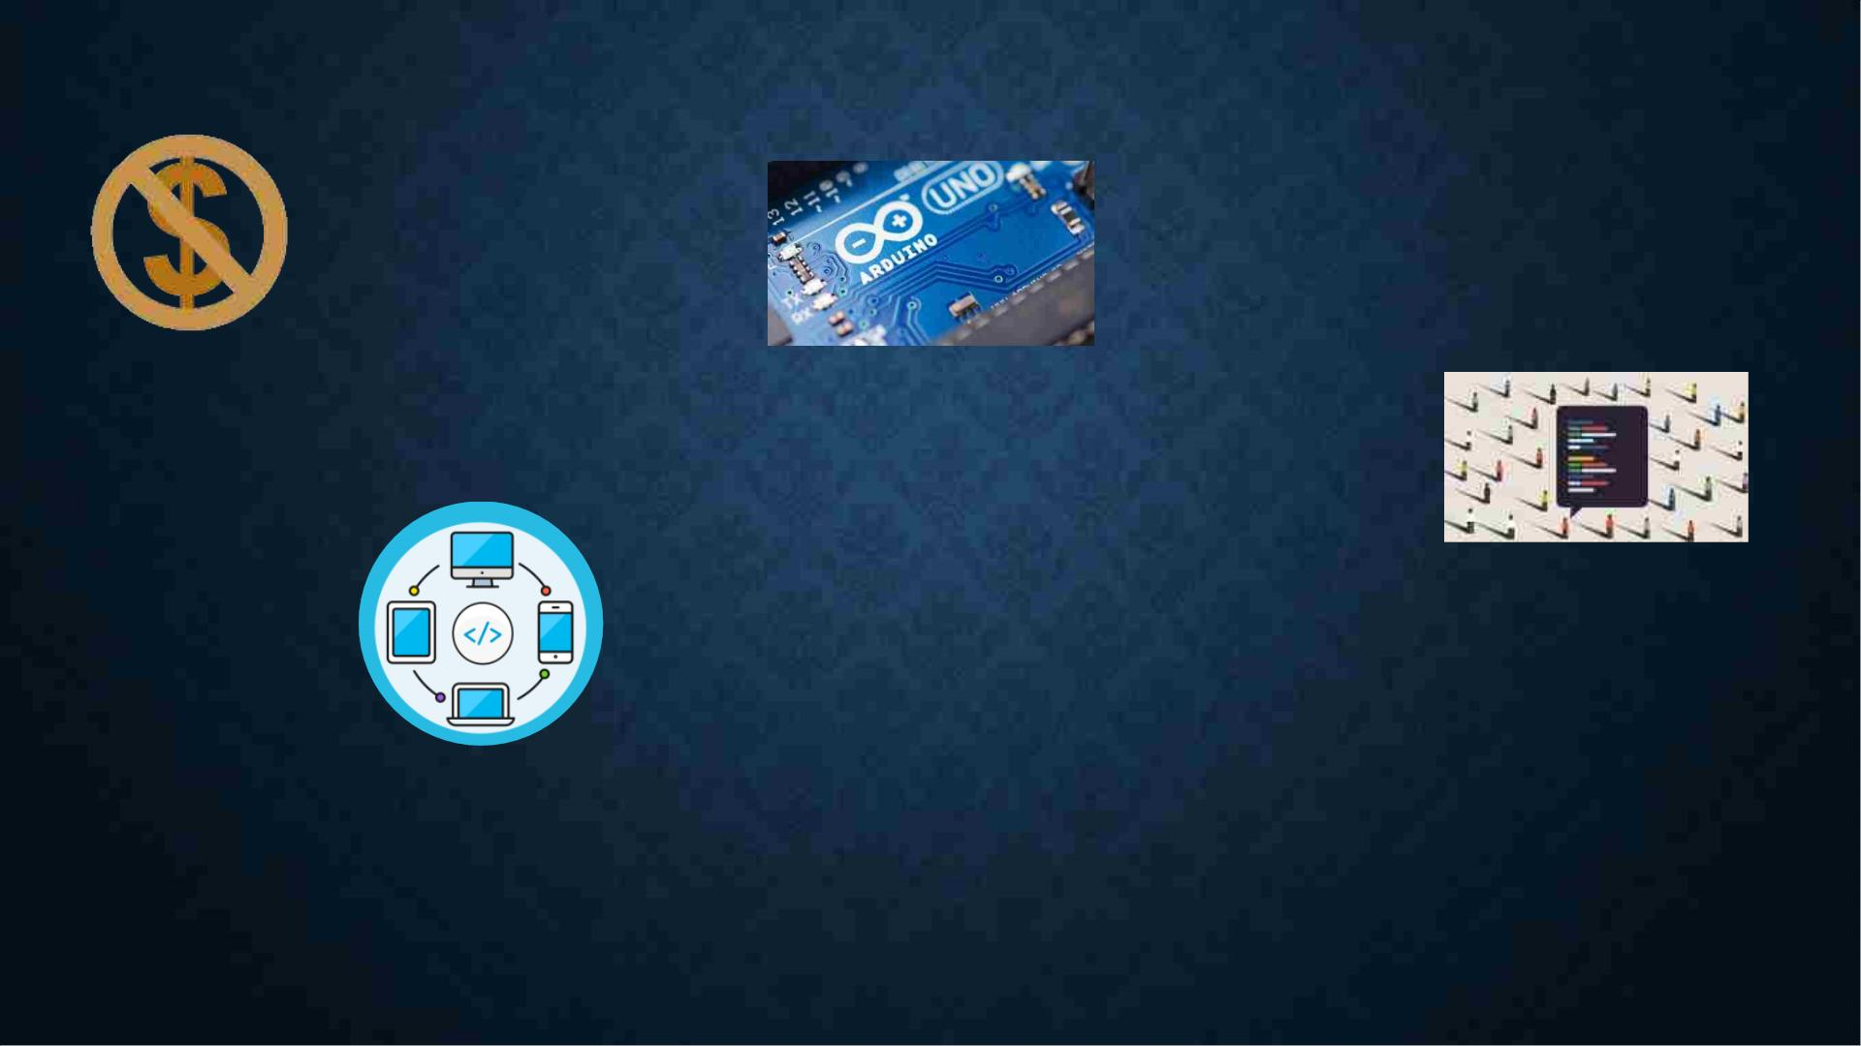
Main reason for WHY ARDUINO:
Inexpensive
Simple, clear
programming
environment
Open source and
extensible software
Cross – Platform
Open source and
extensible hardware

Slide 7
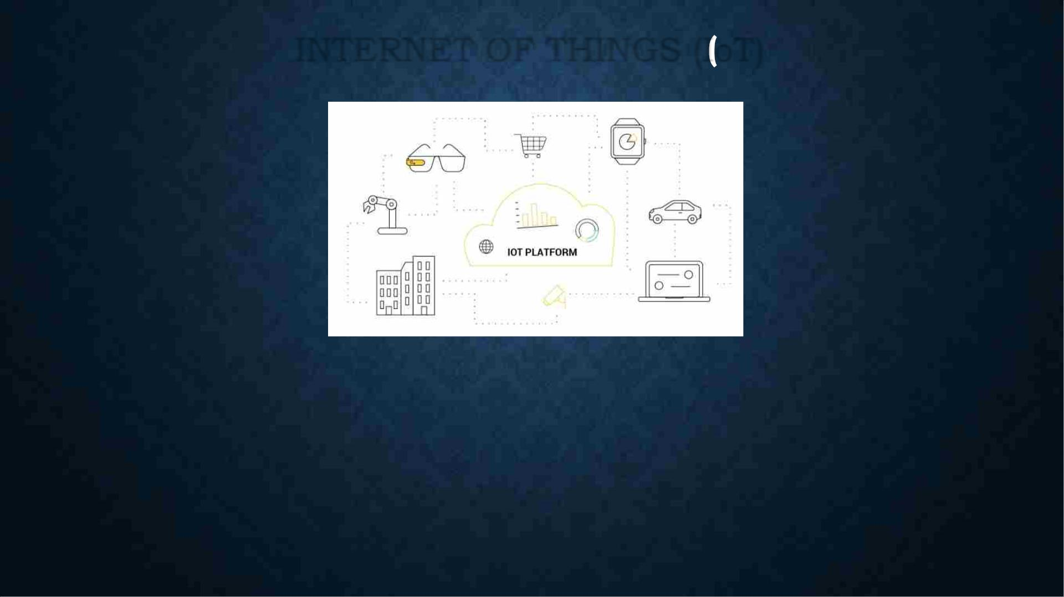
INTERNET OF THINGS IoT)
The Internet of Things (IoT) is the Inter-Networking of “Physical Devices” also referred to as
“Connected Devices” and “Smart Devices”.
IoT expected to offer Advanced Connectivity of devices , systems and services that covers a
variety of protocols, domains and applications.

Slide 8
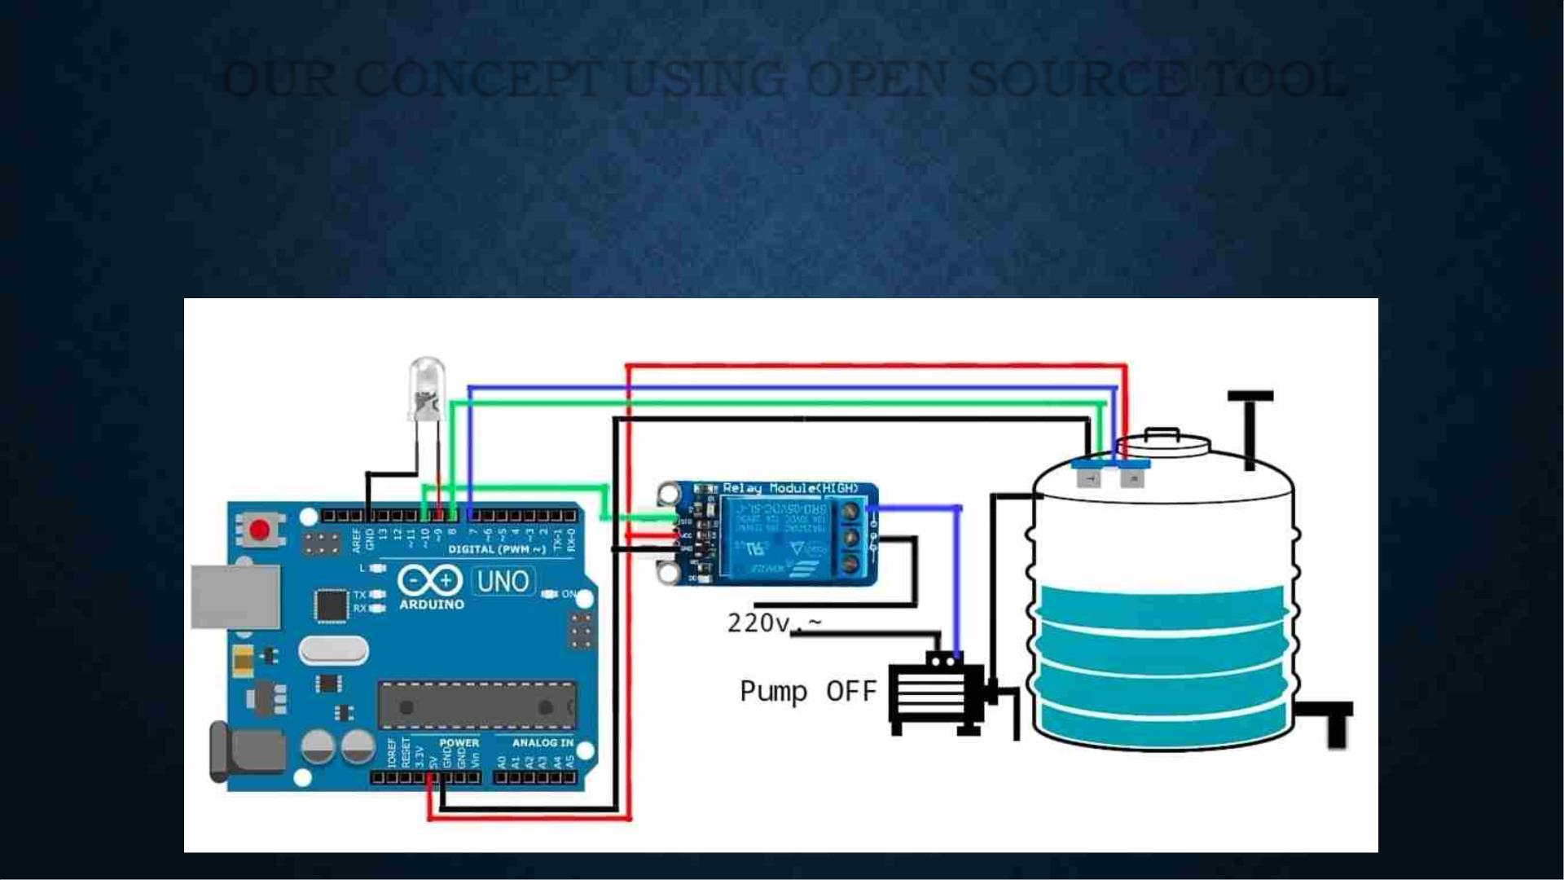
OUR CONCEPT USING OPEN SOURCE TOOL
Our project is on ManuMatic Pumping System which involves both Manual as well as Automatic system
of pumping water to the overhead tank. This project comes under the Iot Domain.

Slide 9
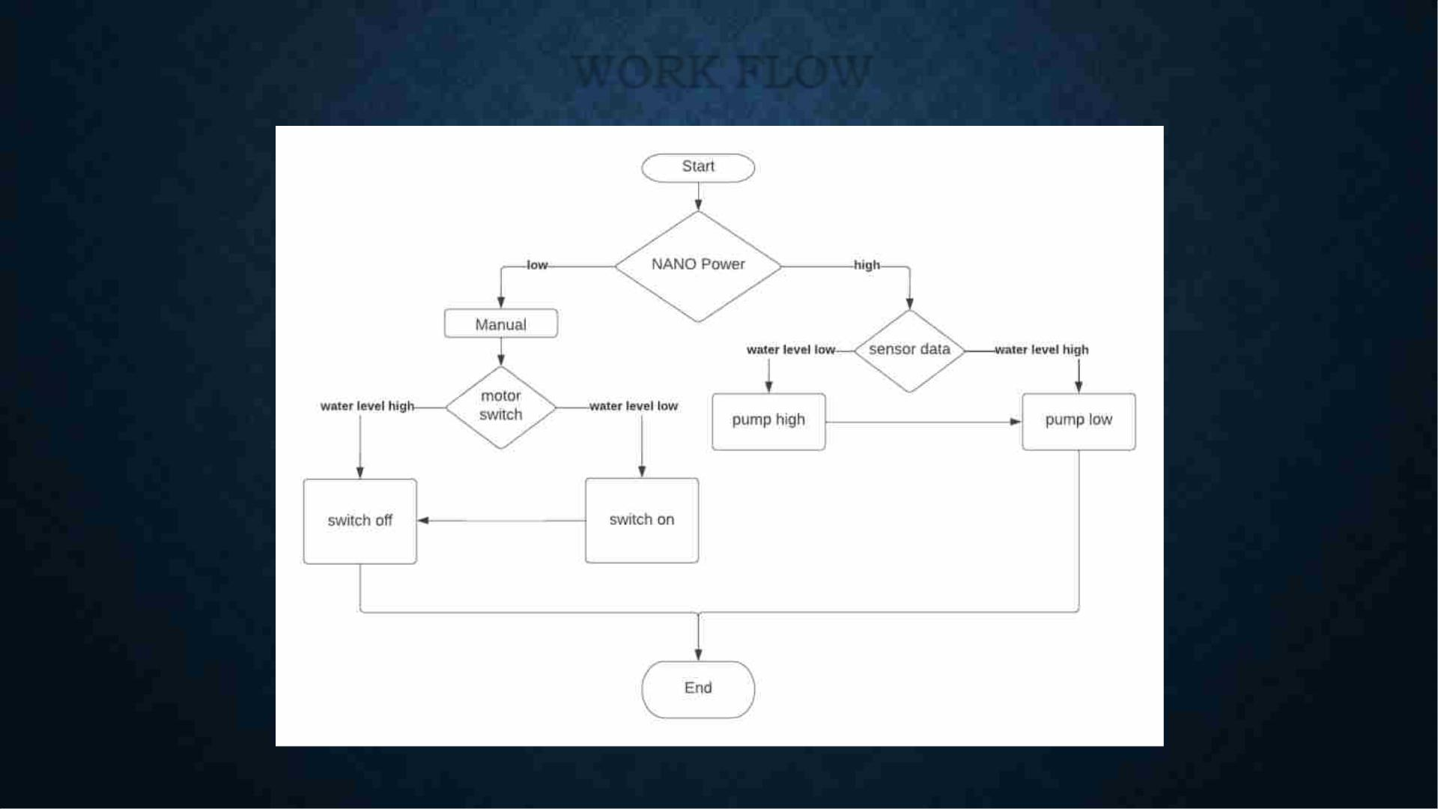
WORK FLOW

Slide 10

WORK FLOW
Step 1: The circuits are connected and are fixed in the tanks.
Step 2: When started the Arduino is been powered under 2 following conditions.
1) When its low its working manual.
2) When its high its working automated
Step 3: Under condition (1)
a) When the water level is low, the motor is switched on manually.
b) When the water level is high, the motor is switched off manually.
Step 4: Under condition (2) The level of the water is sensed by the Ultrasonic Sensor.
a) When the sensor senses the low level of water, the pump is turned on
automatically and is pumped high.
b) When the sensor senses the high level of water, the pump is turned off
automatically and is pumped low.
Step 5: End.

Slide 11
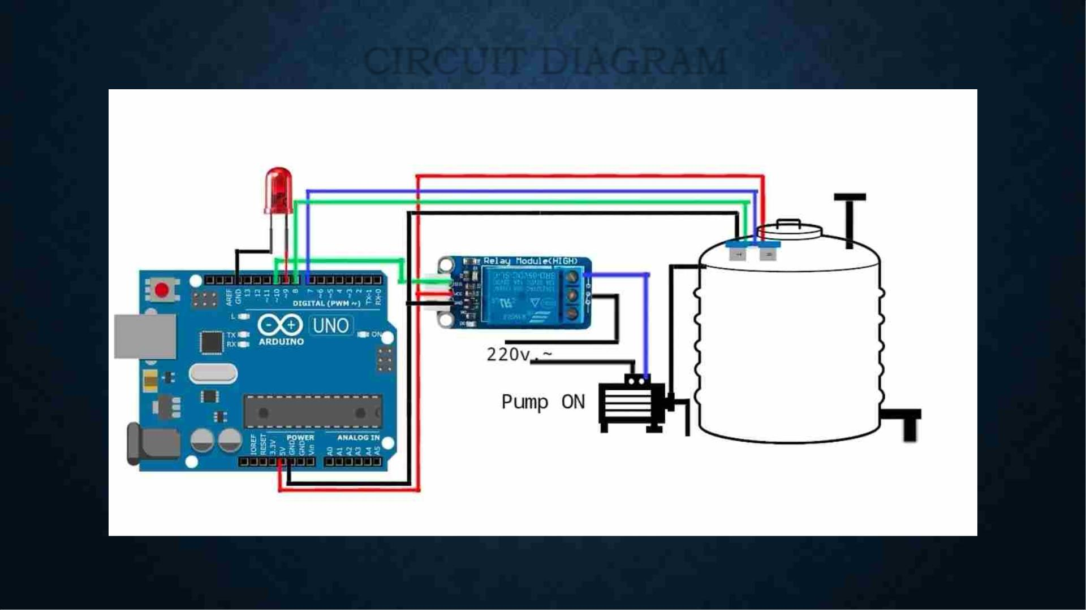
CIRCUIT DIAGRAM
Circuit when the tank is empty

Slide 12
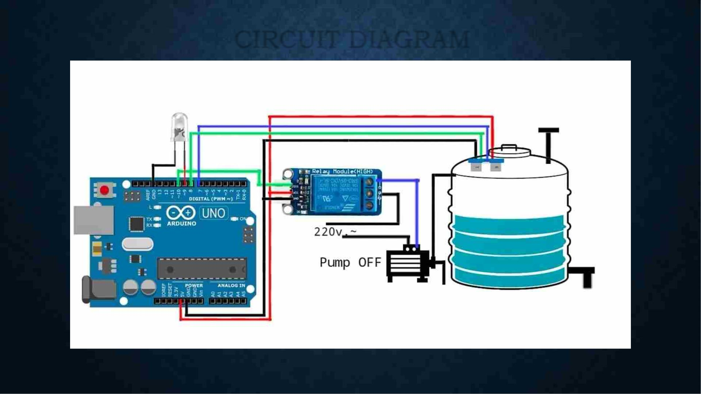
CIRCUIT DIAGRAM
Circuit when the tank is in mid range

Slide 13
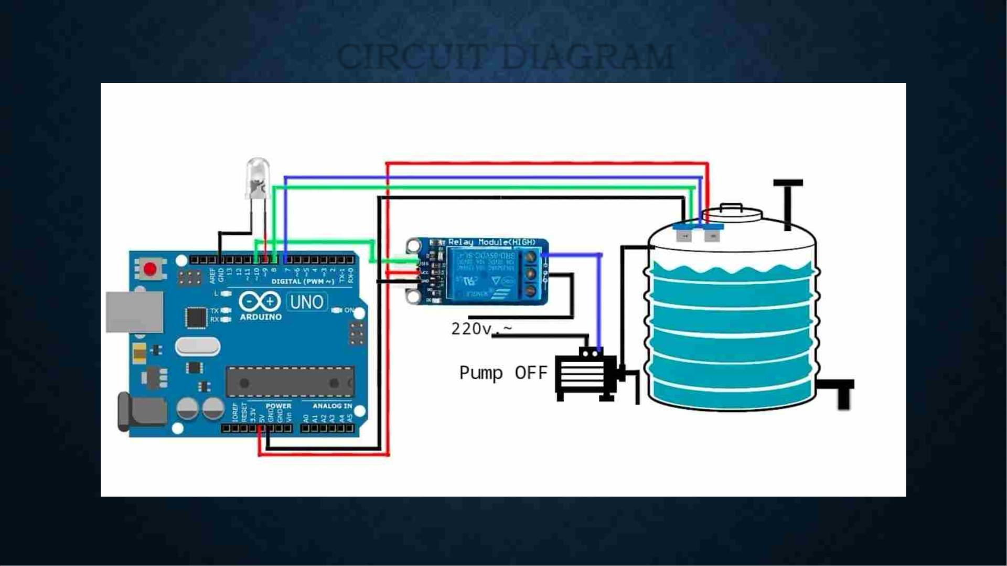
CIRCUIT DIAGRAM
Circuit when the tank is full

Slide 14

ADVANTAGES
• Less Investment
• Easy for Installation
• Prevention of water scarcity
• No passing of current to measure the level of water
• Both Manual and Automatic system can be used
alternatively
• Less in size and weight
• Safe distance of the sensor can be customized
according to the tanks.

Slide 15

CONCLUSION
Water scarcity is one of the biggest problem which are facing in the present and also in the
upcoming years. Wasting the water when its at least used for once is reasonable. But the water
which we all waste without using is the water that overflows from the overhead tanks. The
Manumatic pumping system helps us to prevent the tanks from overflowing and saves water
which are wasted without using.
Thus it’s a smart solution with open source tool!!!

